Slide 1
Workplace bullying in New Zealand: What are all these scandals telling us and what should be done?
Geoff Plimmer
School of Management

Slide 2
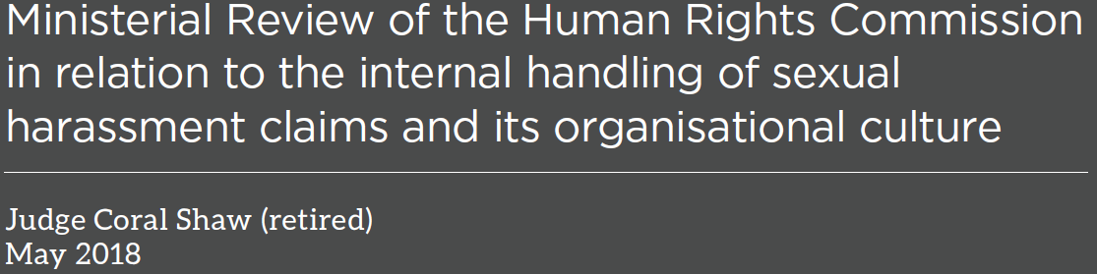
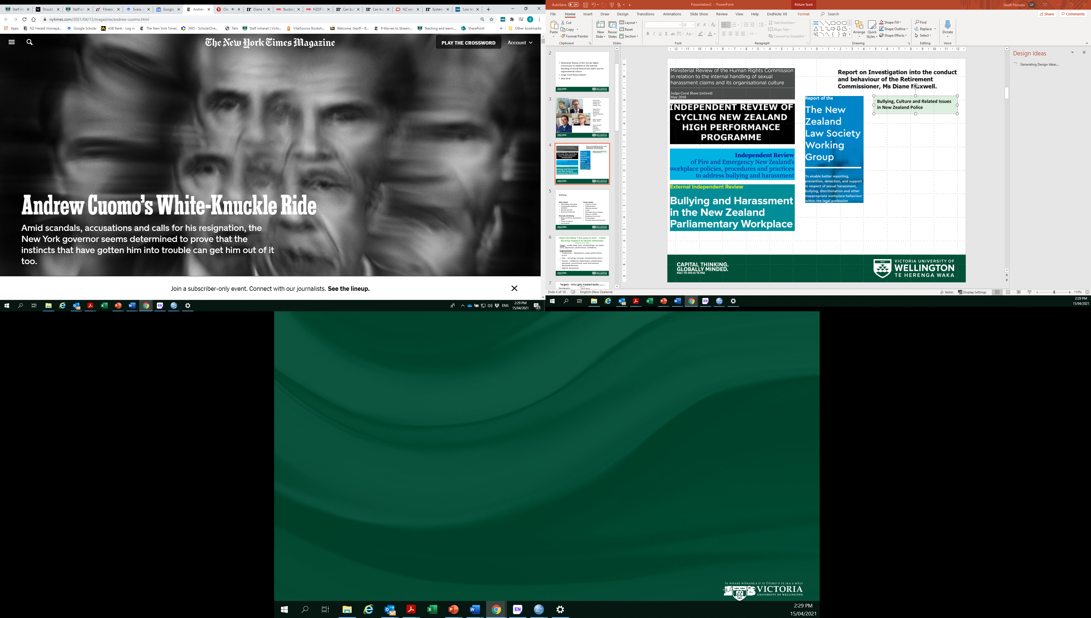
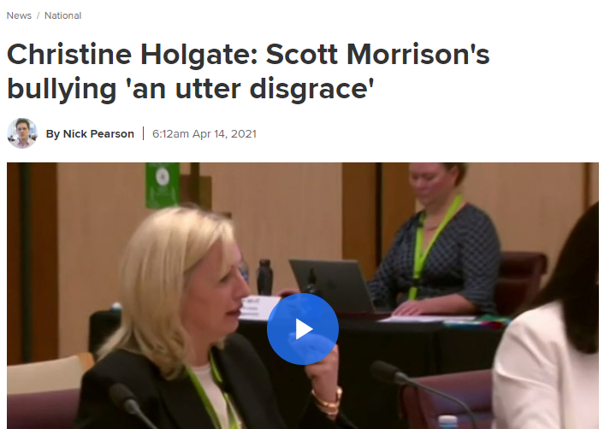
Notes:
Power imbalances
Often involving competitive, high powered careers and/or hierarchical careers and organisations
In some cases sustained and long term, but now coming to attention

Slide 3
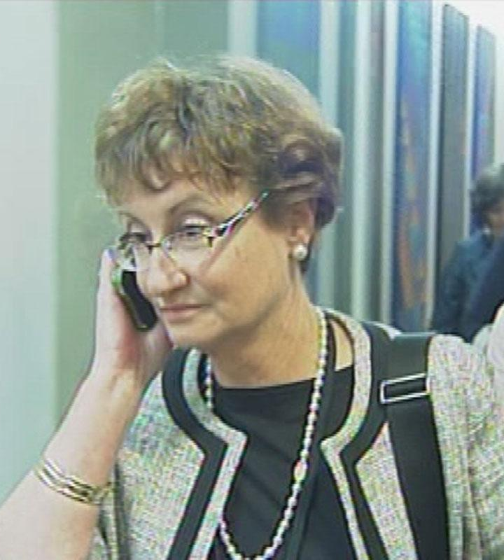
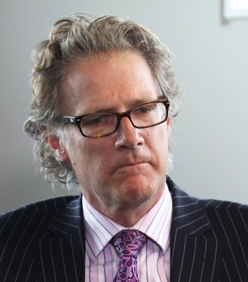

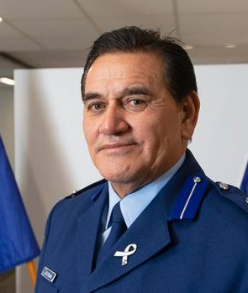
Katrina Bach - Department of Building and Housing – 2012
Roger Sutton – Christchurch Earthquake Recovery Authority – 2014
Wally Haumaha – Police - 2018
Diane Maxwell – Office of retirement Commissioner - 2019
Notes:
Are hard managers effective? Difference between high standards / performance management /decisiveness and abusive behaviour that either manipulative or emotionally disregulated
High standards / tough bosses
Helen Clark

Slide 4
What is it? https://www.worksafe.govt.nz/topic-and-industry/bullying/bullying-at-work-advice-for-workers/#lf-doc-51621
Workplace bullying is: repeated and unreasonable behaviour directed towards a worker or a group of workers that can lead to physical or psychological harm.
>Repeated behaviour is persistent (occurs more than once) and can involve a range of actions over time.
> Unreasonable behaviour means actions that a reasonable person in the same circumstances would see as unreasonable. It includes victimising, humiliating, intimidating or threatening a person.
> Bullying may also include harassment, discrimination or violence
Note: The bullying definition is adapted from Safe Work Australia’s definition.

Slide 5
Bullying
Work related
Withholding information
Unreasonable deadlines, workload
Opinions ignored
Excessive monitoring
Physically intimidating
Being shouted at, spontaneous anger
Threat of violence
Actual abuse
Person related
Gossip or rumors
Social exclusion
Offensive remarks
Insults.
Reminders about mistakes.
Silence or hostility
Devaluing of your work
Practical jokes
Excessive teasing and sarcasm
Notes:
This comes from workplace bullying lit – To meet a technical definition of bullying it must be twice a week for 6 months. Extremely controversial due to harm caused by single acts.
The short term of most cases means would not apply in court, but higher stakes and visibility would make harm of single acts worse.
International consensus but different styles of research.
Notelaers, G., & Einarsen, S. (2008). The construction and validity of the Short Negative Acts Questionnaire. Paper presented at the 6th International Conference on Bullying and Harassment in the Workplace, Montreal, QC.
Worksafe definition: Workplace bullying is: repeated and unreasonable behaviour directed towards a worker or a group of workers that can lead to physical or psychological harm.
Varies by workplace and demographics. If public servants, you would most likely experience withholding information and gossip.
If an ethnic minority, more likely to be given demeaning work, be ignored, excluded or undermined. [Lewis and Gunn, 2007]. But if you are Chinese you are most likely to be ignored, more than anyone else.
Overall white workers get bullied by their bosses more by work related tactics, but for ethnic minorities tends to be more personal.
Eriksen and Einarsen (2004 , p. 473) ‘ The risk associated with being different has been documented by many social and political processes throughout human history ’
If interested, NZ seems to have slightly higher rates of bullying than comparable other countries, higher in public service, armed forces, (total institutions). Hierarchical and competitive sectors and organisations. Like law.
Easy to pretend doesn’t matter – people get used to it. But does hurt – cover later – Chinese student story.
Sir Graham Henry interview – Youtube – coaching in the 70 and 8-0s different , authoritarian. Not acceptable now, ineffective, wouldn’t last at least at tope level. Now more consensus and courteous.

Slide 6
Even subtle behaviours can be harmful – e.g. Incivility (Andersson and Pearson, 1999)
“low-intensity deviant behavior with ambiguous intent to harm the target, in violation of workplace norms for mutual respect. Uncivil behaviors are characteristically rude and discourteous, displaying a lack of regard for others.”
Sarcasm, disparaging tones and remarks, hostile stares etc.
Intent is ambiguous
Intentionally ‘hide discriminatory intentions behind “general” incivility, which allows [perpetrators] … to retain an egalitarian image and escape sanctions.” (p.457)
Low physical and mental health, sexual harassment, job satisfaction, social capital, trust, effort and confidence
High turnover intention, retaliation
Notes:
72% - bullying / harassment allegations in public service are not sustained 2010 – 2016 (Crimp, 2017)

Slide 7
Impact of bullying “I fear going to work ….It feels like being trapped in an abusive relationship” (Chambers et al., 2018)
Target – cardio, body mass, alcohol/drugs, lost sleep, work, depression, performance, confidence
Organisational
Productivity – absenteeism, lower performance, errors
Cost - recruiting, turnover, compensation claims
Culture – ineffective relationships, collaboration, teamwork, commitment, work environment, ‘displaced deviance’
Legal & reputational
Notes:
Quote form study of senior medical consultants
Seems occur regardless of social class, education job and gender Hogh et al., 2008
A key finding of this study is the demonstrated severity of the mental health problems following exposure to bullying, leading to serious psychiatric pathologies in people who previously presented no significant psychiatric history. (Brousse et al., 2008)
PTSD – after two years of bullying, symptoms exceeded those of three comparison groups – parents of school children in fatal bus crash,
Bullying is becoming increasingly exposed through public means – Parliament, sport teams, surgeons, public service CEOs
Large productivity and absenteeism effects have been hard to verify – with mixed results. But the better studies using objective (absenteeism data for instance) seem to have stronger results

Slide 8
Targets - Who gets treated badly [Samnani & Singh, 2016]
Demographic
- Numerical minority status
Dispositional
- Negative Affect
- Low Self-Esteem
- Hostility
Work Role
- Role Conflict/Ambiguity
- Job Insecurity
- Role Overload
- Task Autonomy
- Social Support
- Skill Utilization
- Group Identification
Notes:
And high and low performers

Slide 9
How common is it?
18% - Bentley et al (2009) survey of NZ workers
32% - NZ Public Service (Plimmer et al., 2013)
25% of “State servants considering they have personally experienced bullying or harassment in the last 12 months” (SSC, 2013)
13% - NZ Public Service (NAQ2) (Plimmer et al., 2016)
24.9% - Chambers et al. NAQ2 (2018)
18.3% - Cooper Thomas NAQ2 (2013)
21% women, 13% men (Gardner et al., 2020)
Notes:
Seems slightly higher in NZ – 18%, 13%??
Denmark 7%
Italy 10.1%
Serbia 16, 12.8
Czech 14.3
Switzerland 4.6
Israel 22
Canada 7.8 , 14.7
Barbados 54!
Peru 26
South Korea 15.8, 17.2
Pakistan 36.8, 47.9

Slide 10
Bullying in the NZ Public Service -Negative Acts Questionnaire (Notelaers & Einarsen, 2008)
Bullying items | Never (%) | Now and then | Monthly | Weekly | Daily
Someone withholding necessary information so that your work gets complicated. | 41.5 | 43.6 | 5.0 | 6.8 | 3.1
Gossip or rumours about you. | 53.1 | 36.4 | 3.6 | 4.4 | 2.5
Social exclusion from co-workers or work group activities. | 65.6 | 26.2 | 2.6 | 3.0 | 2.6
Repeated offensive remarks about you or your private life. | 81.8 | 13.7 | 1.6 | 1.9 | 1.0
Insults. | 78.5 | 16.6 | 1.6 | 2.0 | 1.2
Repeated reminders about your blunders or mistakes. | 67.1 | 26.4 | 2.8 | 2.6 | 1.1
Silence or hostility as a response to your questions or attempts at conversations. | 65.0 | 25.6 | 3.2 | 4.0 | 2.3
Devaluing of your work and efforts. | 60.7 | 28.5 | 4.2 | 4.3 | 2.2
Practical jokes carried out by people you don’t get on with. | 88.8 | 9.2 | .8 | .7 | .5

Slide 11
Sectors at risk
Government, health, defense, hospitality
Why government?
Whingers? Poor job clarity? Intense and complex social interaction that creates desire and opportunity? Performance management by other means? Weak managers?

Slide 12
High bullying/misconduct organisation (Agervold, 2009)
Work demands
Time pressure of work
Autocratic or laissez faire management style
Un-clarity of duties
Social climate (cliques, conflicts amongst peers)
Total organisations – compliance & discipline
Informality – too people oriented, tolerant
Competition and rewards – making omelettes

Slide 13
Organisations split between high and low bullying (Plimmer et al., 2013)
High bullying organisations were rated worse at…..
All included
Non-bullied respondents agreed about the following
Organisational processes
Cross - unit co-operation
Managem’t responsvn’s
Social climate (trust and support)
Autonomy
Rewards
Knowledge
Job goal specificity
Less cross unit co-operation
Less Managem’t responsiveness
Worse social climate
Higher commitment!

Slide 14
What to do about it?
Primary: Prevention
What the literature says
What happens (Crimp, 2017)
Development and implementation of an organisational anti-bullying policy
Staff and management training in a range of areas including bullying recognition and reporting, conflict management and interpersonal communication
The identification of bullying antecedents
Use of selection policies to screen-out applicants with undesirable traits (use with caution!)
Development of policies generally following best practice
Policy content focused on secondary intervention, few specific preventative measures
Anything else?

Slide 15
Secondary: Management
What the literature says
What happens
Development of formal complaint investigation process
Mediation for complaint resolution
Provision of social support services
Managerial training in conflict management and complaint investigation
Formal investigation processes generally sound
Media

Slide 16
Tertiary: Ongoing management
What the literature says
What happens
Integrated counselling programs
Inpatient treatment for victims
Physiotherapy and physical exercise
Monetary and non-monetary forms of redress
Group recovery programs
EAP?
MBIE mediation used for restoration of relationships?
……..

Slide 17
Other ideas - How to prevent it?
Policies – as statement of intent AND to guide stakeholders thru informal & formal processes
Broad or updateable definitions -advised
Organisation owned – health and safety
Bring “variability” issue into open
Focus on bystander action and prevention
High involvement in design - “our problem”
Leadership team support
Implementation, communicating, embedding, protocols on confidentiality

Slide 18
References
Agervold, M. (2009). The significance of organizational factors for the incidence of bullying. Scandinavian Journal of Psychology, 50(3), 267-276.
Andersson, L. M., & Pearson, C. M. (1999). Tit for tat? The spiraling effect of incivility in the workplace. Academy of Management Review, 452-471.
Bentley, T., Catley, B., Cooper-Thomas, H., Gardner, D., O’Driscoll, M., & Trenberth, L. (2009). Understanding Stress and Bullying in New Zealand Workplaces. New Zealand: Massey University, University of Auckland, University of Waikato and Birkbeck University of London.
Chambers, C. N., Frampton, C. M., McKee, M., & Barclay, M. (2018). ‘It feels like being trapped in an abusive relationship’: bullying prevalence and consequences in the New Zealand senior medical workforce: a cross-sectional study. BMJ open, 8(3).
Cooper‐Thomas, H., O'Driscoll, M., Bentley, T., Trenberth, L., Catley, B., & Gardner, D. (2013). Neutralizing workplace bullying: the buffering effects of contextual factors. Journal of Managerial Psychology, 28(4), 384-407. doi:10.1108/JMP-12-2012-0399
Gardner, D., Roche, M., Bentley, T., Cooper-Thomas, H., Catley, B., Teo, S., & Trenberth, L. (2020). An exploration of gender and workplace bullying in New Zealand. International Journal of Manpower.
Plimmer, G., Bryson, J., Donnelly, N., Wilson, J., Ryan, B., & Blumenfeld, S. (2017). The legacy of New Public Management (NPM) on workers, management capabilities, and organisations. New Zealand Journal of Employment Relations, 42(1), 19-34.
Plimmer, G., Proctor-Thomson, S., Donnelly, N., & Sim, D. (2017). The mistreatment of public service workers: identifying key risk and protective factors. Public Money & Management, 37(5), 333-340.
Plimmer, G., Norman, R. and Gill, D. (2011), “Skills and people capability in the future state: needs, barriers and opportunities”, in Ryan, B. and Gill, D. (Eds), Future State: Directions for Public Management in New Zealand, VUP, Wellington, pp. 281-305.
Plimmer, G., Wilson, J., Bryson, J., Blumenfeld, S., Donnelly, N. and Ryan, B. (2013), Workplace Dynamicsin New Zealand Public Services, Industrial Relations Centre, Victoria University of Wellington, Wellington.
Samnani, A. K., & Singh, P. (2016). Workplace bullying: Considering the interaction between individual and work environment. Journal of business ethics, 139(3), 537-549.

